Slide 1
Display Basics

Slide 2
Flat Panel Displays
Flat-Panel Display refers to a class of display devices that have reduced volume, weight and power requirements compared to CRT.
There are two categories of flat panel displays:
Emissive Displays
Non-Emissive Displays
Emissive Displays (or emitters) are devices that convert electrical energy into light. Plasma Panel (PDP) and light emitting diodes (LED) are examples of emissive displays.
Non-emissive displays ( or non-emitters) use optical effects to convert sunlight or light from some other source into graphics pattern e.g Liquid Crystal Display (LCD)

Slide 3
Liquid Crystal Display (LCD)
A liquid crystal display is a thin, flat display device made up of any number of pixels arrayed in front of a light source or reflector.
It uses very small amounts of electric power, and is suitable for use in battery-powered electronic devices.
Colour displays are possible by incorporating colour filters.
The heart of all liquid crystal displays (LCDs) is a liquid crystal itself. A liquid crystal is a substance that flows like a liquid, but its molecules orient themselves in the manner of a crystal.
That is, it is an organic compounds, whose macroscopic behavior resemble that of liquid but shows physical properties of crystals.
A plane has nematic-like structure, but with each plane molecules change their direction. As a result the molecules display a helical twist through the material.
They have characteristics like: rod-like molecular structure, or easily polarizable constituents.

Slide 4
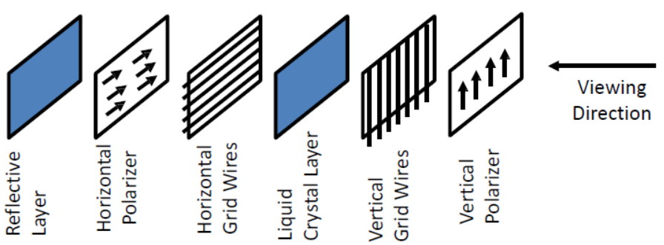
LCD Construction
Each pixel of an LCD consists of a layer of molecules aligned between two transparent electrodes, and two polarizing filters, whose axes are perpendicular.
Orientation of the liquid crystal molecules is determined by the alignment at the surfaces.
Six Layers:

Slide 5
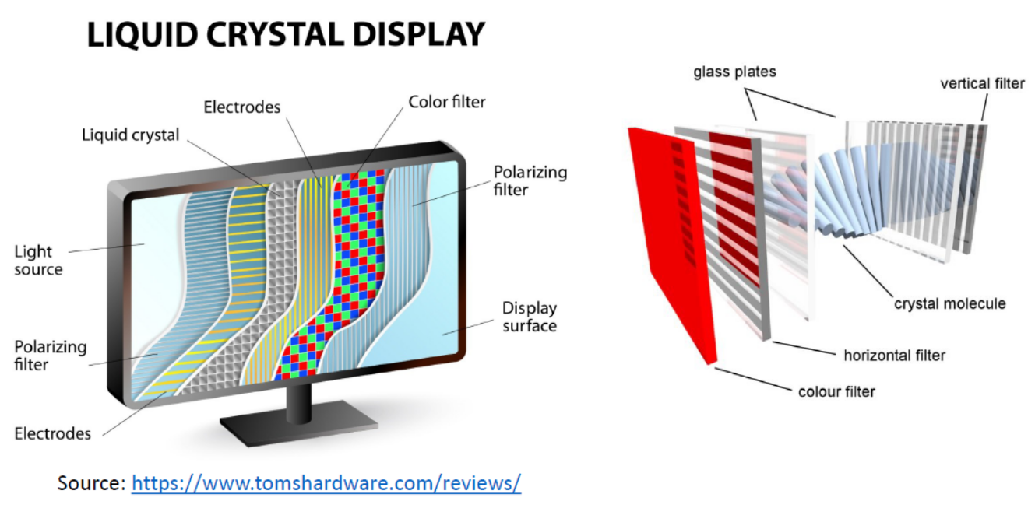

Slide 6
Types of Liquid Crystals
Nematic Liquid Crystal – molecules are aligned in the same direction but not arranged in layers.
Smectic Liquid Crystal – molecules form layered structures.
Cholesteric Liquid Crystal – molecules form a twisted or spiral arrangement.

Slide 7
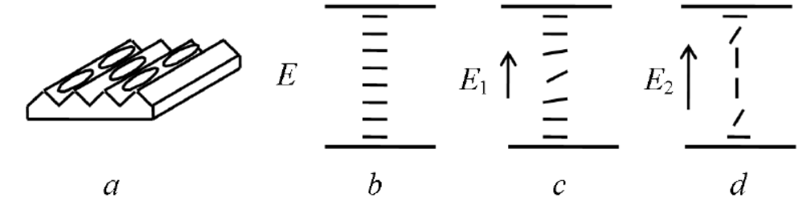
Basic Principle
Most of the LCDs use twisted nematic cells.
When a nematic liquid crystal material comes into contact with a solid surface molecules become aligned either perpendicular to the surface (homeotropic ordering) or parallel to the surface (homogeneous ordering).
These two forms can be produced by suitable treatment of the surface.
The most important electrical characteristic of liquid crystal materials is that the direction of the molecules can be controlled by the electric field. Usually the molecules tend to be orientated along the electric field.

Slide 8
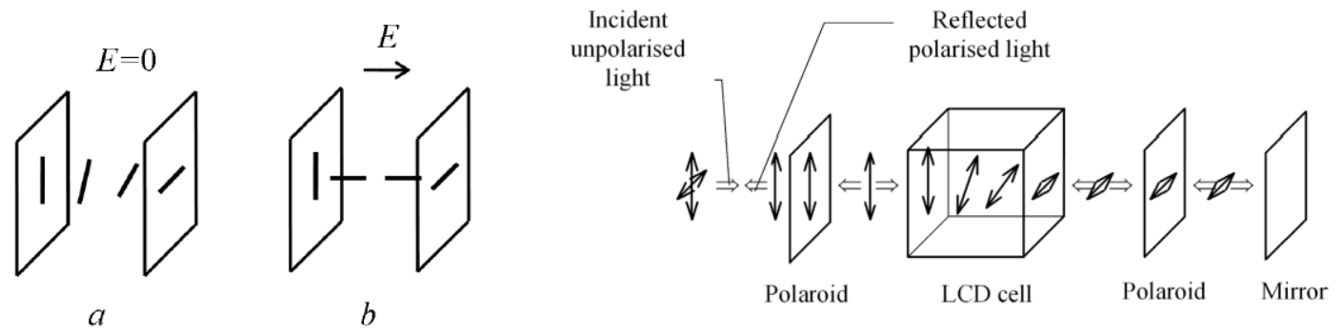
Basic Principle (2)
When a beam of polarised light is incident on the cell the liquid causes rotation of polarisation plane.
A strong enough electric field changes orientation of molecules and in this state the molecules have no effect on an incident light beam.

Slide 9
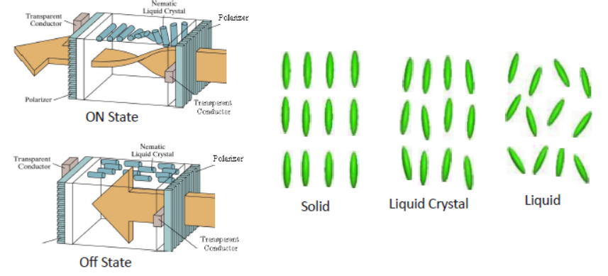
Characteristics

Slide 10
Working Principle of LCD
Before applying Electric field, the molecules arrange themselves in a helical structure, or twist.
When a voltage is applied across the electrodes, a torque acts to align the liquid crystal molecules parallel to the electric field, distorting the helical structure .
This reduces the rotation of the polarization of the incident light.
Classification of LCD:
Transmissive displays:
Transmission LCD displays do not have the reflector and must be provided with rear illumination. They operate in a very similar fashion to the reflective displays.
It is illuminated from the back by a backlight and viewed from the opposite side (front). Ex: Computer display.
Reflective displays:
It is illuminated by external light reflected by diffusing reflector behind the display. Ex: Calculator.

Slide 11
Applications, Advantages & Limitations of LCD
Applications:
LCDs with a small number of segments, are used in digital watches and pocket calculators, Small monochrome displays in personal organizers, or older laptop screens
High-resolution color displays such as modern LCD computer monitors and televisions;
Advantages:
An LCD cell consumes only microwatts of power over a thousand times less than LED displays.
LCDs can operate on voltages as low as 2 to 3 V and are easily driven by MOS IC drivers.
Limitations:
They cannot be seen in the dark,
They have a limited viewing angle;
They can be operated in limited temperature range.

Slide 12
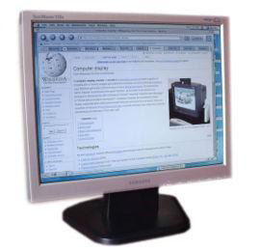
Thin Film Transistor (TFT) Technology
Normal LCDs like those found in calculators have direct driven image elements – a voltage can be applied across one segment without interfering with other segments of the display.
This is impractical for a large display with a large number of picture elements (pixels), since it would require millions of connections - top and bottom connections for each one of the three colors (red, green and blue) of every pixel.
To avoid this issue, the pixels are addressed in rows and columns which reduce the connection count from millions to thousands.
The solution to the problem is to supply each pixel with its own transistor switch which allows each pixel to be individually controlled.
A thin film transistor (TFT) is a special kind of field effect transistor made by depositing thin films for the metallic contacts, semiconductor active layer, and dielectric layer.
TFT-LCD (Thin Film Transistor Liquid Crystal Display) is a variant of liquid crystal display (LCD) which uses thin film transistor (TFT) technology to improve image quality.
TFT LCD is one type of active matrix LCD. It is usually synonymous with LCD.
It is used in both flat panel displays and projectors.

Slide 13
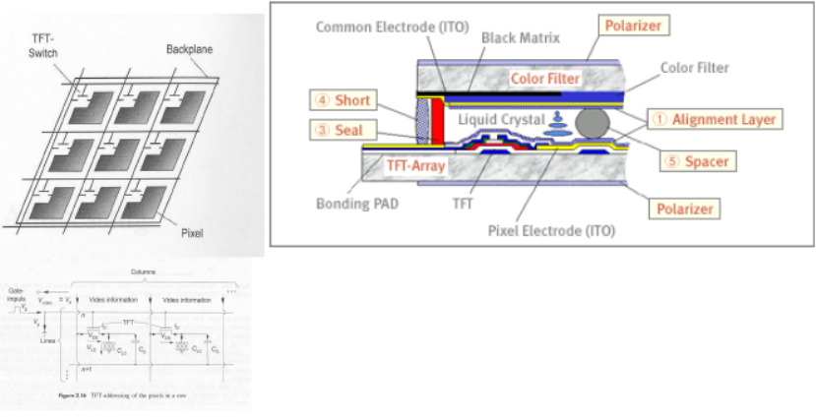
TFT-LCD

Slide 14
Construction of TFT Displays
Material:
TFTs are Metal-Insulator-Semiconductor Field Effect Transistors, which are used more often as bottom-gate.
Indium tin oxide (ITO) is usually employed for the electrodes.
Most TFTs are not transparent themselves, since many of them are based on hydrogenated amorphous silicon (A-Si:H) (A-Si, used as Gate-dielectric) have Low mask count; Small number of mask alignments and requires less processing steps).
The bandgap od S-Si is assumed to be less than that of crystalline silicon (1.12eV).
Construction:
A transistor switch which allows each pixel be individually controlled.
Each pixel is a small capacitor with a transparent ITO [indium tin oxide ]layer at the front, a transparent layer at the back, and a layer of insulating liquid crystal between (refer to figure in previous slide).
All the pixels in one row are driven with a positive voltage and all the pixels in one column are driven with a negative voltage.

Slide 15
Advantages and Disadvantages of TFT
Advantages:
Fast response time has been a great feature of TN (twisted nematics) displays.
Lower cost of production
Less noise or glitter seen on the panel surface
Disadvantages:
The TFT display suffers from limited viewing angles, especially in the vertical direction.
They are unable to display the full 16.7 million colors (24-bit true color) available from modern graphics cards.

Slide 16
Plasma Display
A plasma display panel (PDP) is a type of flat panel display, suitable and now commonly used for large TV displays (typically above 37-inch or 940 mm.
Construction:
The xenon and neon gas in a plasma television is contained in hundreds of thousands of tiny cells positioned between two plates of glass.
Long electrodes are also sandwiched between the glass plates, in front of and behind the cells.
Cell are covered with a magnesium oxide protective layer.

Slide 17
Working of PDP
Control circuitry charges the electrodes that cross paths at cell,
This creates a voltage difference between front and back and causing the gas to ionize and form a plasma.
As the gas ions rush to the electrodes and collide, photons are emitted.
In color panels, the back of each cell is coated with a phosphor. The ultraviolet photons emitted by the plasma excite these phosphors to give off colored light.
The display panel is only about 6 cm (2½ inches) thick, and total thickness less than 10 cm.
They can be produce fairly large sizes, up to 262 cm (103 inches) diagonally.
Bright scenes (say a football game) will draw significantly more power than darker scenes.
Limited life time: Their lifetime is estimated at 60,000 hours

Slide 18
Advantages and Disadvantages
Advantages:
Supports large displays ,up to 103 inches diagonally.
Overall thickness of monitor is less than 10 cm. and can be installed on a wall.
Faster response time, Greater color spectrum, Wider viewing angle
Disadvantages:
They are costly as compared to CRT, LCD displays.
Burn-in problem:
Static images can leave a permanent mark on screen. That is why they are not used in computer monitors and video game displays.

